Slide 1
CP Level 2 - Python
Life is short
(You need Python)
Notes:
Bruce Eckel (ANSI C++ Comitee member)

Slide 2

Guido von Rossum

Slide 3
Chapter 1
Python installation
Windows
Mac OS
Running Python
Interactive Mode Programming
Script Mode Programming
Python basic syntax

Slide 4
Chapter 1 - Python Installation
https://www.python.org/downloads/source/
v3.7.4
https://www.vim.org/download.php#pc
gvim81.exe

Slide 5
Chapter 1 - Running Python
Windows
Open Command line: Start menu -> Run and type cmd
Type: C:\python\python.exe
Mac OS
Open Command line: Finder -> Go menu -> Applications -> Terminal
Type: python

Slide 6
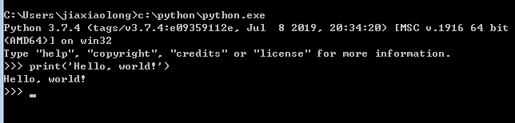
Chapter 1 - Running Python
Interactive Mode Programming

Slide 7
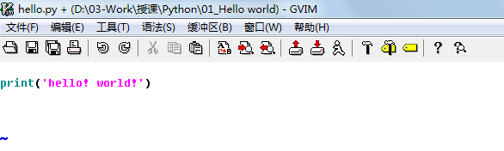
Chapter 1 - Running Python
Script Mode Programming
hello.py

Slide 8
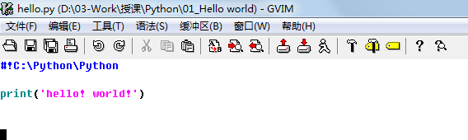
Chapter 1 - Running Python
Script Mode Programming
hello.py

Slide 9
Chapter 1 - Running Python
Script Mode Programming
Basic vi Commands (https://www.cs.colostate.edu/helpdocs/vi.html)
<Esc> : Turn off the insert mode
:w!<Return> : force to write current contents to file opended in original vi call
:q!<Return> : force to quit vi call
i : Insert text before cursor until <Esc> hit
o : Open and put text in a new line below current line until <Esc> hit
dd : Delete entire current line
a : Insert text after cursor until <Esc> hit

Slide 10
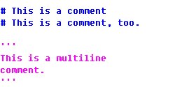
Chapter 1 - Python Basic syntax
Comments
A hash sign (#) that is not inside a string literal is the beginning of a comment. All characters after the #, up to the end of the physical line, are part of the comment and the Python interpreter ignores them.
Following triple-quoted string is also ignored by Python interpreter and can be used as a multiline comments.
Notes:
three double quotes (“””) are the same thing.

Slide 11
Chapter 1 - Python Basic syntax
Python Identifiers
A Python identifier is a name used to identify a variable, function, class, module or other object.
An identifier starts with a letter A to Z or a to z or an underscore (_) followed by zero or more letters, underscores and digits (0 to 9).
Python does not allow punctuation characters such as @, $, and % within identifiers
Python is a case sensitive programming language. Thus, Manpower and manpower are two different identifiers in Python

Slide 12
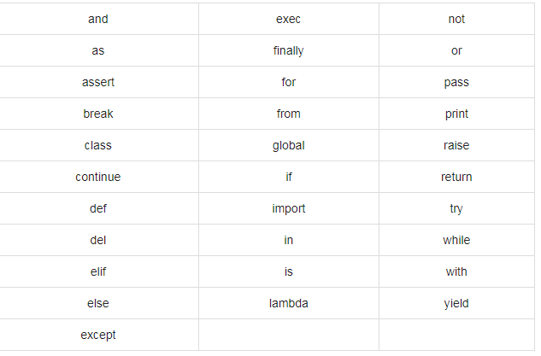
Chapter 1 - Python Basic syntax
Reserved Words

Slide 13
Chapter 1 - Python Basic syntax
Lines and Indentation
Python does not use braces({}) to indicate blocks of code for class and function definitions or flow control.
Blocks of code are denoted by line indentation, which is rigidly enforced.

Slide 14
Chapter 1 -- Review
Please describe two ways to add comments in Python program.
Please tell which Python identifer in below is incorrect?
(a) __File__ (b) Days (c) list%number (d) Wed_Tue
How to insert text after cursor when editing Python program via Vim?
How to declare the Python interpreter in the first line of Python program?

Slide 15
Chapter 2 Variables
Assigning Values to Variables
Multiple Assignment
Standard Data Types
Numbers
String
List
Tuple
Dictionary

Slide 16
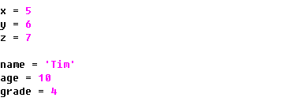

Chapter 2 Variables
Assigning Values to Variables
Multiple Assignment

Slide 17
Chapter 2 Variables
Standard Data Types
Numbers
int (signed integers)
bool (True, False)
float (floating point real values)
complex (complex numbers)
0b, 0o, 0x
String
List
Tuple
Dictionary

Slide 18
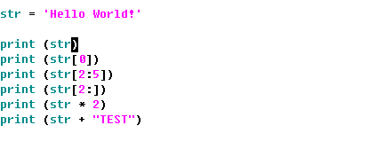
Chapter 2 Variables
Standard Data Types
Numbers
String （ + %s \ r””）
List
Tuple
Dictionary
Notes:
String, List, Tuple的下标截取（左右两种方向）

Slide 19
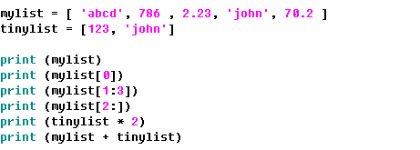
Chapter 2 Variables
Standard Data Types
Numbers
String
List
Tuple
Dictionary
Notes:
mylist.append() mylist.pop()

Slide 20
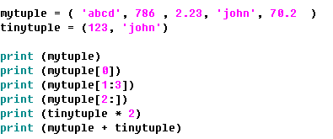
Chapter 2 Variables
Standard Data Types
Numbers
String
List
Tuple
Dictionary
Notes:
myTuple = (‘aaa’,)

Slide 21
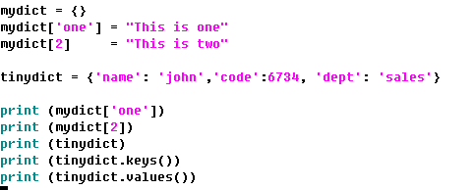
Chapter 2 Variables
Standard Data Types
Numbers
List
Tuple
Dictionary
Notes:
The main difference between lists and tuples are − Lists are enclosed in brackets ( [ ] ) and their elements and size can be changed, while tuples are enclosed in parentheses ( ( ) ) and cannot be updated. Tuples can be thought of as read-only lists.

Slide 22
Chapter 2 -- Review
Please tell their data types:
-123 _____ 38.123 _____ [1, ‘aa’] _____ {‘a’:’1’} ____ (1, ‘aa’) ____
How would you express the constant floating-point value 3.2 × 10-12 in Python:
Which of the following are valid ways to specify the string literal foo'bar in Python: "foo'bar" 'foo\'bar' """foo\'bar""" 'foo'bar'
How would you express the hexadecimal value a5 as a base-16 integer constant in Python?

